Slide 1


Slide 2
Agenda
Develop A Simple Forecast In Detail

Slide 3
Forecasting
Forecasting is the process of making predictions of the future value, based on past and present data. Most commonly by analysis of trends. A common example might be estimation of some variable of interest (e.g. Electricity Consumption) at some specified future date.

Slide 4
Developing A Simple Forecast (Continued)

Slide 5
Terms Used In Developing An Energy & Demand Forecast (Continued)
Annual Average Compound Growth Rate (AACGR) = Compound Annual Growth Rate (CAGR)
Annual Growth in (%)
Load Factor
Difference Between Energy (GWh) & Demand (MW)
Energy Shed (GWh)
Demand Shed (MW)
Recorded Peak (Service Meter Reading)
Computed Peak
Diversity Factor

Slide 6
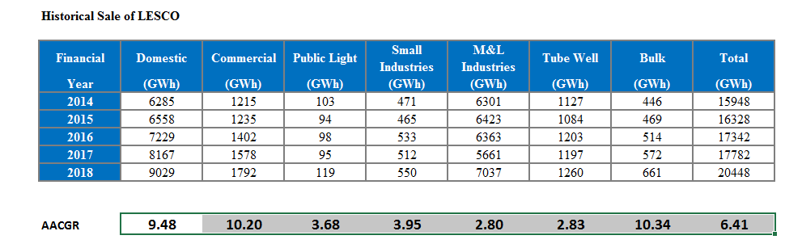

Slide 7
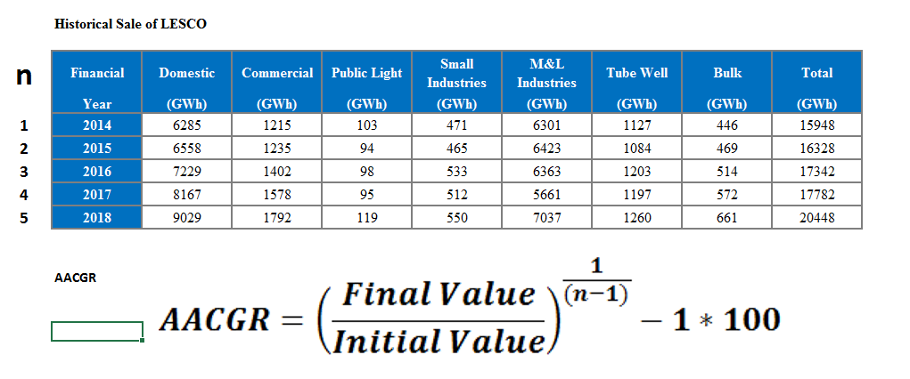

Slide 8
Make Projection of Each Category Using Excel Sheet to Compute Total Sale
By Taking any Growth Rate
By Estimating growth

Slide 9

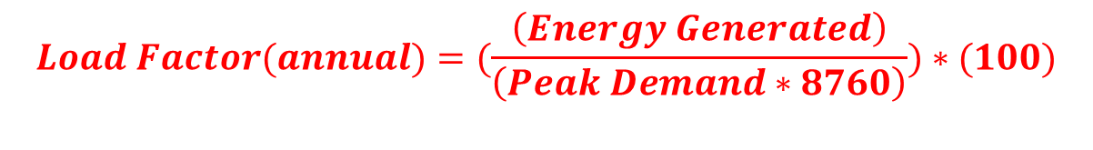
$$Load Factor(annual)=(\frac{\left(Energy Generated\right)}{\left(Peak Demand∗8760\right)})∗(100)$$
How To Calculate Next Years Figure Using Previous Years Figure And Percentage Growth Rate
$$Next Year Figure= \left(Previous Year Figure\right)∗( 1+\frac{\%Growth Rate}{100} )$$

Slide 10
How To Calculate Annual Average Compound Growth Rate (AACGR)

Slide 11
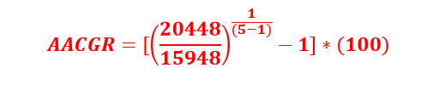
Historical Sale of LESCO
Financial Total Sale
n Year (GWh)
1 2014 15948
2 2015 16328
3 2016 17342
4 2017 17782
5 2018 20448
AACGR 6.41
Please Make A Projection Of 2018 Sale Using 5% Growth Rate For Next Five Years.

Slide 12
How To Calculate Annual Load Factor

Slide 13


LESCO Data 2018
Energy Generated = 23731 GWh
Peak Demand = 3861 MW
$$Load Factor(annual)=(\frac{\left(Energy Generated\right)}{\left(Peak Demand∗8760\right)})∗(100)$$

Slide 14
Steps In Developing Simple Forecast
I Step : Complete Base Year Figures
II Step : Adding Distribution Losses (%)
III Step : Adding Transmission Losses (%)
IV Step : Computing Total Losses (%)
V Step : Calculating Energy Sent out
VI Step : Applying Load Factor
VII Step : Calculating Peak Demand

Slide 15
LESCO Forecast without incorporating Load Shedding effect (Low Forecast)
Year | Energy Sale |  | Distribution Losses |  | Energy Received at 11 kV | Peak Demand at 11 kV | Transmission Losses |  | Energy Sent out at 132 kV | Load Factor | Peak Demand at 132 kV
 | (GWh) | G.R | (GWh) | (%) | GWh | MW | (GWh) | (%) | (GWh) | (%) | (MW)
2017-18 | 20448 |  | 3046 | 12.96 | 23495 | 3822 | 237 | 1.00 | 23731 | 70.2 | 3861
2018-19 | 21621 | 5.7 | 3173 | 12.80 | 24794 | 4130 | 248 | 0.99 | 25042 | 68.5 | 4172
2019-20 | 23316 | 7.8 | 3311 | 12.43 | 26627 | 4479 | 264 | 0.98 | 26890 | 67.9 | 4524
2020-21 | 24952 | 7.0 | 3451 | 12.15 | 28403 | 4810 | 278 | 0.97 | 28681 | 67.4 | 4857
2021-22 | 26514 | 6.3 | 3623 | 12.02 | 30137 | 5133 | 292 | 0.96 | 30429 | 67.0 | 5183
2022-23 | 28197 | 6.4 | 3811 | 11.91 | 32009 | 5448 | 307 | 0.95 | 32316 | 67.1 | 5500
2023-24 | 29827 | 5.8 | 4016 | 11.87 | 33844 | 5802 | 322 | 0.94 | 34165 | 66.6 | 5858
2024-25 | 31576 | 5.9 | 4241 | 11.84 | 35817 | 6186 | 337 | 0.93 | 36154 | 66.1 | 6244
2025-26 | 33410 | 5.8 | 4475 | 11.81 | 37885 | 6593 | 352 | 0.92 | 38237 | 65.6 | 6655
2026-27 | 35184 | 5.3 | 4736 | 11.86 | 39920 | 7001 | 367 | 0.91 | 40287 | 65.1 | 7065
2027-28 | 37034 | 5.3 | 4936 | 11.76 | 41970 | 7360 | 382 | 0.90 | 42352 | 65.1 | 7427
Ave. Growth (2018-2028) | 6.12% |  |  |  | 5.97% | 6.77% |  |  | 5.96% |  | 6.76%

Slide 16
